Slide 1
Highly Available Architecture
AWS Essentials
SoftUni Team
Technical Trainers
Software University
https://softuni.org

Slide 2
Table of Contents
1. AWS Shared Responsibility Model
2. Elastic Load Balancers
3. Elastic Beanstalk

Slide 3
Have a Question?
sli.do
# AWS-essentials

Slide 4

Shared Responsibility Model

Slide 5
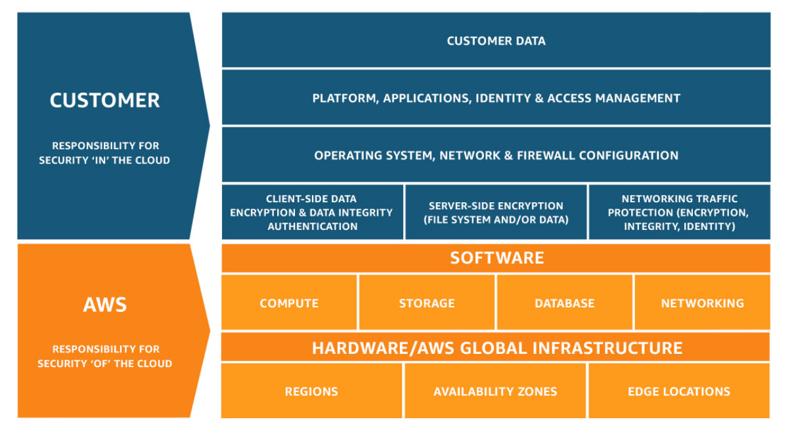
What is Shared Responsibility Model ?
The Model defines what you (as an AWS account owner/user) and Amazon Web Services, are responsible for when it comes to security and compliance

Slide 6
DDOS and Penetration Testing
AWS customers are allowed to carry out penetration testing or security assessments against some of AWS services without prior approval. The services are :
EC2, NAT Gateways, ELB
RDS, Aurora , Cloudfront
API Gateway, Lambda, Lambda Edge
Lightsail, Elastic Beanstalk
AWS Penetration Testing

Slide 7
Other Security Related Services
AWS Organizations
Amazon GuardDuty
Amazon Inspector
AWS Shield
AWS Web Application Firewall (WAF)
AWS Artifact

Slide 8

What is Elastic Load Balancer ?

Slide 9
Load Balancer Types
Application Load Balancers are best suited for load balancing of HTTP and HTTPS traffic. They operate at Layer 7 and are application aware. They are intelligent, and you can create advanced request routing, sending specified requests to specific web server.
https://www.geeksforgeeks.org/layers-of-osi-model/

Slide 10
Load Balancer Types
Network Load Balancers are best suited for load balancing of TCP traffic where extreme performance is required. Operating at the connection level ( Layer 4 ), NLBs are capable of handling millions of requests per second , while maintaining super low latency.

Slide 11
Load Balancer Types
Classic Load Balancers are the Legacy Load Balancers. You can load balance HTTP/HTTPS applications and use features like sticky session and X-Forwarded. You can also use strict Layer 4 load balancing.

Slide 12


Plan For Failure
Everything fails
Always plan for failure
Netflix Simian Army

Slide 13
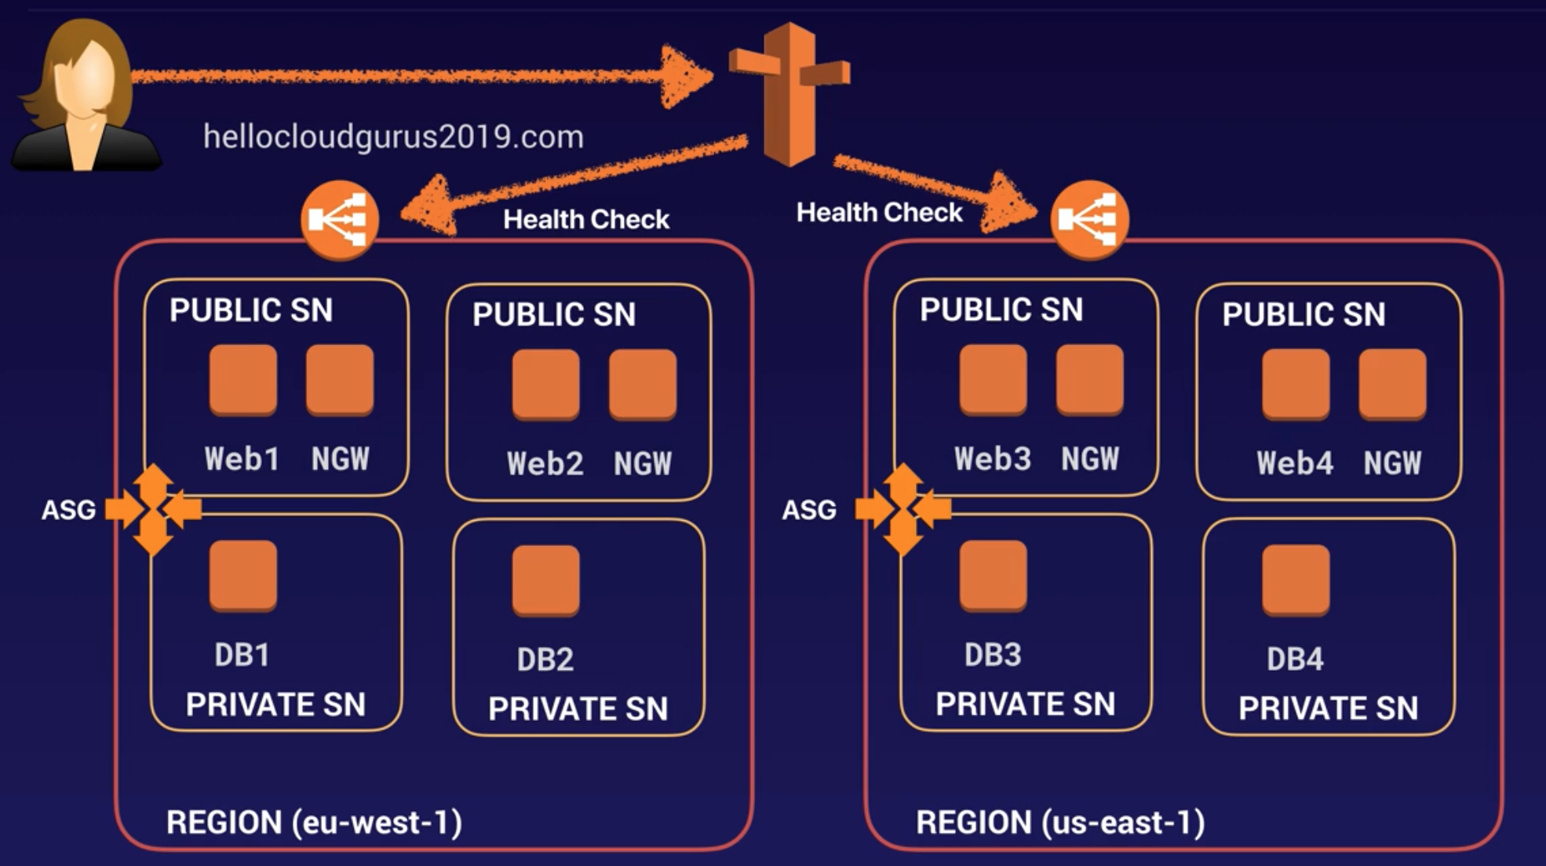
Highly Available Architecture

Slide 14

What is Elastic Beanstalk?

Slide 15
Elastic Beanstalk
Elastic Beanstalk is an easy-to-use service for deploying and scaling web applications and services developer with Java, PHP, GO, Node, Rube, Docker.

Slide 16

AWS Whitepapers
AWS Whitepapes
Service Documentation
Netflix path
Workshops
List of beginner/advanced workshops

Slide 17

Summary
AWS Shared Responsibility Model
Elastic Load Balancers
Elastic Beanstalk
…
…
…

Slide 18
Questions?

Slide 19











SoftUni Diamond Partners

Slide 20



Educational Partners

Slide 21
Trainings @ Software University (SoftUni)
Software University – High-Quality Education, Profession and Job for Software Developers
softuni.bg, about.softuni.bg
Software University Foundation
softuni.foundation
Software University @ Facebook
facebook.com/SoftwareUniversity
Software University Forums
forum.softuni.bg

Slide 22

License
This course (slides, examples, demos, exercises, homework, documents, videos and other assets) is copyrighted content
Unauthorized copy, reproduction or use is illegal
© SoftUni – https://about.softuni.bg/
© Software University – https://softuni.bg

